Slide 1


Como comunicar la nueva ley RGPD
¿No sabes como comunicar a tus usuarios la entrada en vigor de la nueva Ley Europea de Protección de Datos y dar cumplimiento a la misma? Aquí tienes diferentes ejemplos de cómo lo están haciendo algunas empresas que te pueden servir de guía a la tuya

Slide 2
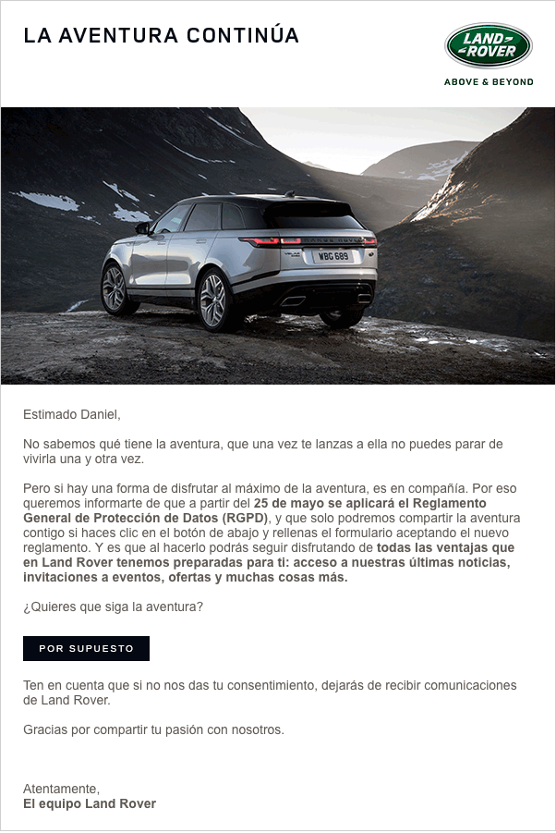
Corporativo
Utilizando el lenguaje de la marca
Notes:
To change the image behind the Mock up.
Select the layer - > Right Click -> Send to Back -> Delete the image -> Drag & Drop your Own Picture -> Send to Back (again)

Slide 3
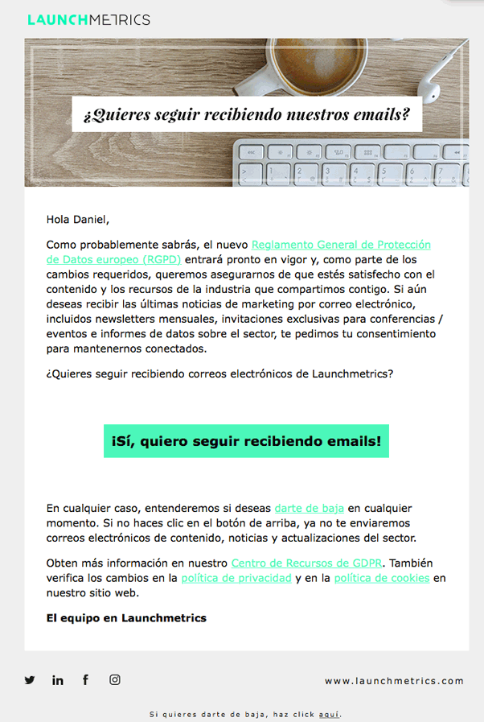
Corporativo
Con un CTA claro
Notes:
To change the image behind the Mock up.
Select the layer - > Right Click -> Send to Back -> Delete the image -> Drag & Drop your Own Picture -> Send to Back (again)

Slide 4
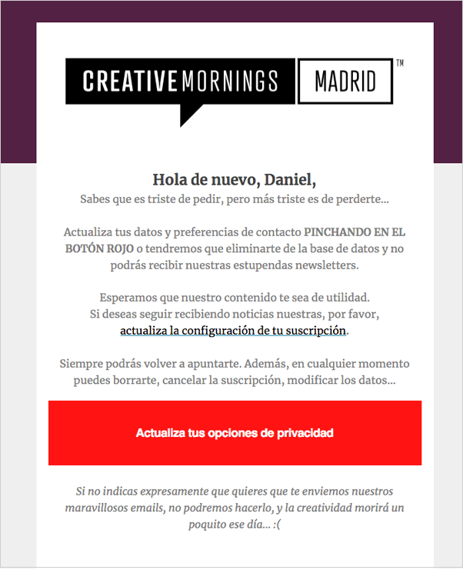
Corporativo
Con un tono amigable un CTA claro
Notes:
To change the image behind the Mock up.
Select the layer - > Right Click -> Send to Back -> Delete the image -> Drag & Drop your Own Picture -> Send to Back (again)

Slide 5
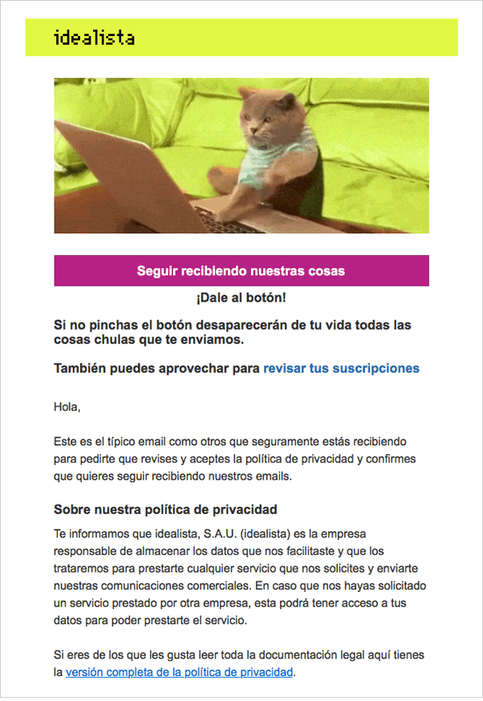
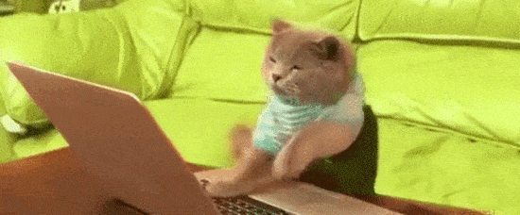
En clave de humor
Con gif animado
Notes:
To change the image behind the Mock up.
Select the layer - > Right Click -> Send to Back -> Delete the image -> Drag & Drop your Own Picture -> Send to Back (again)

Slide 6
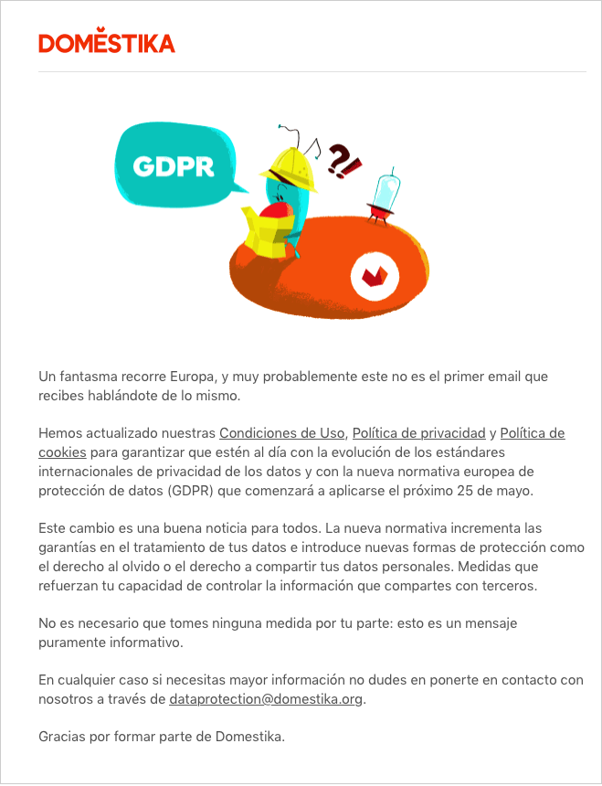
En clave de humor
Sin solicitud de optin
Notes:
To change the image behind the Mock up.
Select the layer - > Right Click -> Send to Back -> Delete the image -> Drag & Drop your Own Picture -> Send to Back (again)

Slide 7
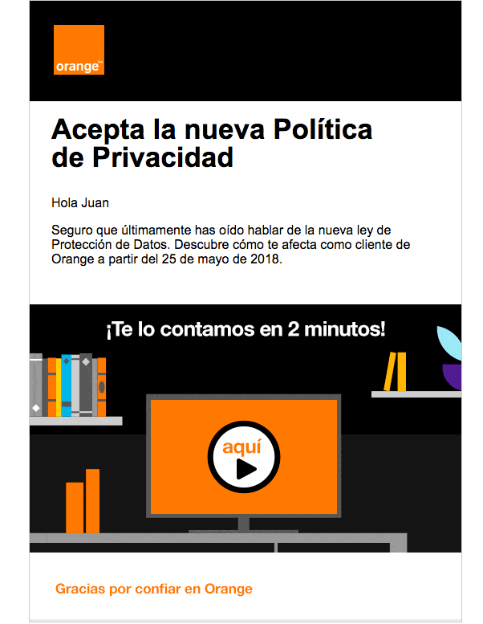
Corporativo
Con video personalizado y explicativo
Notes:
To change the image behind the Mock up.
Select the layer - > Right Click -> Send to Back -> Delete the image -> Drag & Drop your Own Picture -> Send to Back (again)

Slide 8
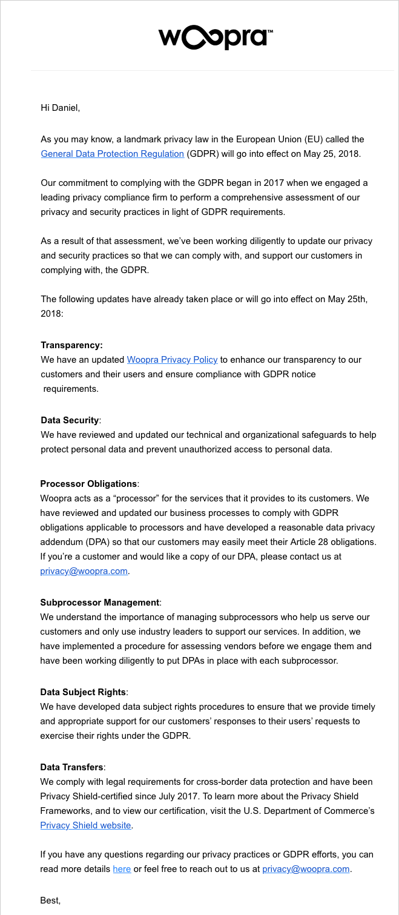
Corporativo
Con explicación minuciosa
Notes:
To change the image behind the Mock up.
Select the layer - > Right Click -> Send to Back -> Delete the image -> Drag & Drop your Own Picture -> Send to Back (again)

Slide 9

Corporativo
Informativo
Notes:
To change the image behind the Mock up.
Select the layer - > Right Click -> Send to Back -> Delete the image -> Drag & Drop your Own Picture -> Send to Back (again)

Slide 10

Corporativo
Con video explicativo en Youtube
Notes:
To change the image behind the Mock up.
Select the layer - > Right Click -> Send to Back -> Delete the image -> Drag & Drop your Own Picture -> Send to Back (again)

Slide 11

Corporativo
Informativo, sencillo y sin optin.
Notes:
To change the image behind the Mock up.
Select the layer - > Right Click -> Send to Back -> Delete the image -> Drag & Drop your Own Picture -> Send to Back (again)

Slide 12

Corporativo
Sencillo y con solicitud de opt in
Notes:
To change the image behind the Mock up.
Select the layer - > Right Click -> Send to Back -> Delete the image -> Drag & Drop your Own Picture -> Send to Back (again)

Slide 13
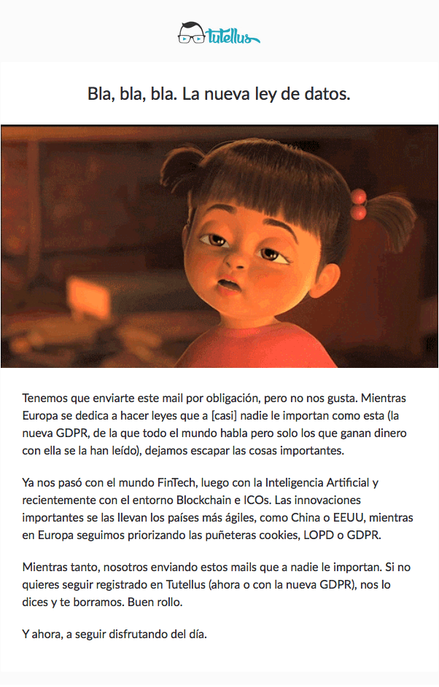
Lo que se debe evitar
La comunicación no debe de tener como objetivo manifestar la importancia o no que tiene la nueva GDPR y expresar nuestra opinión personal
Notes:
To change the image behind the Mock up.
Select the layer - > Right Click -> Send to Back -> Delete the image -> Drag & Drop your Own Picture -> Send to Back (again)

Slide 14
DIRECCIÓN
CONTACTO
C/Castillo de Fuensaldaña, 4
P. Baja Oficina 14.
28232 Lass Rozas
(+34) 91 056 56 82
contacto@rumpelstinski.es
www.rumpelstinski.es

